Slide 1
Department of Computer Science and Engineering
UCS2265 Fundamentals and Practice of Software Development
Software for University Course Registration
By :
Lakshman Vijay V I - 3122 23 5001 072
Meghna Manimaran - 3122 23 5001 079
Rahul Malaikani - 3122 23 5001 103

Slide 2
Problem Statement
Develop a software system for taking care of course registration in a university. This system should have the following features:
Each student should log into the system to register for the chosen courses in each semester.
Once the student logs in, a list of courses that are offered in that semester should be displayed along with the information about faculty members who are teaching each section of the course.
Assume that each core course will have 3 sections and each elective course will have two sections.
Students can choose the courses in which they would like to register.
Each student should register for a minimum of 4 and a maximum of 6 courses per semester
At the end of the registration process, the list of successfully allotted courses along with the name of the teacher for each course should be displayed. In addition, the list of waitlisted courses along with waitlist number should also be displayed.

Slide 3
Constraints
A student should be able to register in a particular course only if he/she has already completed all prerequisites for that course.
Each course can be offered by multiple faculty members • Every section will have a fixed strength. If the section fills up, further registration should not be allowed.
A waitlist(10% of the class strength) will be maintained in case the allotment is not possible in the first round.
If a student wants to add or drop any course after initial registration, it should be allowed only within the first two weeks after the semester starts.
Students from the waitlist can be allotted their choice subsequent to the processing of drop requests.

Slide 4
Input
Output
Student-id
Prerequisites
For each course
Course Code
Course Name
Name of the Faculty Member
Course Code
Course Name
Name of the Faculty Member
Allotment Status(yes/No)
Waitlist Number if Allotment Status is “No”

Slide 5
Executive Summary
The course registration system streamlines student course selection and enrollment processes in the university. It enables students to log in, view available courses with faculty details, and register for 4 to 6 courses per semester.This project is significant because it enhances the efficiency and transparency of course registration processes within the university, providing students with a user-friendly platform to easily select and enrol in their desired courses.
Various stages of Course allotment process:
Registration for different courses in the University
Ranking of the students on the basis of their qualification and satisfaction of prerequisites
Choice Filling by the students (students are required to fill their priority list of the courses and faculty of their preference)
Allocation of seats to students based on availability and eligibility.

Slide 6
Problem Statement Exploration
Problem Statement Exploration
Prerequisite Score:
During the first semester, all students will have common courses.
For registration of courses in the upcoming semesters, the criteria for ranking students could be done based on their prerequisite score, which is calculated using the cgpa and attendance of the student.
Prerequisite score = 80% cgpa + 20% attendance
Credits constraint
The student is allowed to pick any number of courses from 4 to 6 while at the same time maintaining a total sum of credits from 10 to 15.
The core courses carry 4 credits while the electives carry 2 credits.
For example,
A person can pick one core course and 3 electives (4+2+2+2) or
two core courses and 3 electives (4+4+2+2+2) or
Any other combination of their choice

Slide 7
Functional Requirements
1. Login Page a. To enter Username and Password b. To check if the student exists in the database and allow or deny access. The Login() function is called until a right user logs in.
2. Choice Filling
a. To add choices
b. To remove choices
The ChoiceFilling() function is called until the user enters 4-6 courses
3. Seat Allotment Process
a. To check for seat availability
The SeatAllotment() function is used to check the availability of the course for the next person on the rank list of users who picked the same course and allots courses accordingly. In case of excess number of applicant for the same course, the students get waitlisted(10% of the class’s strength). It is displayed when the student checks allotment status.
4. Waitlist allotment
After the seat allotment process is over, the student gets to accept or withdraw the course. If they withdraw, then the vacancy is updated in the waitlist csv file. The waitlist allotment function checks for availability of seats in the database and allots the course to student based on the updates availability.

Slide 8
DATA FLOW DIAGRAMS

Slide 9
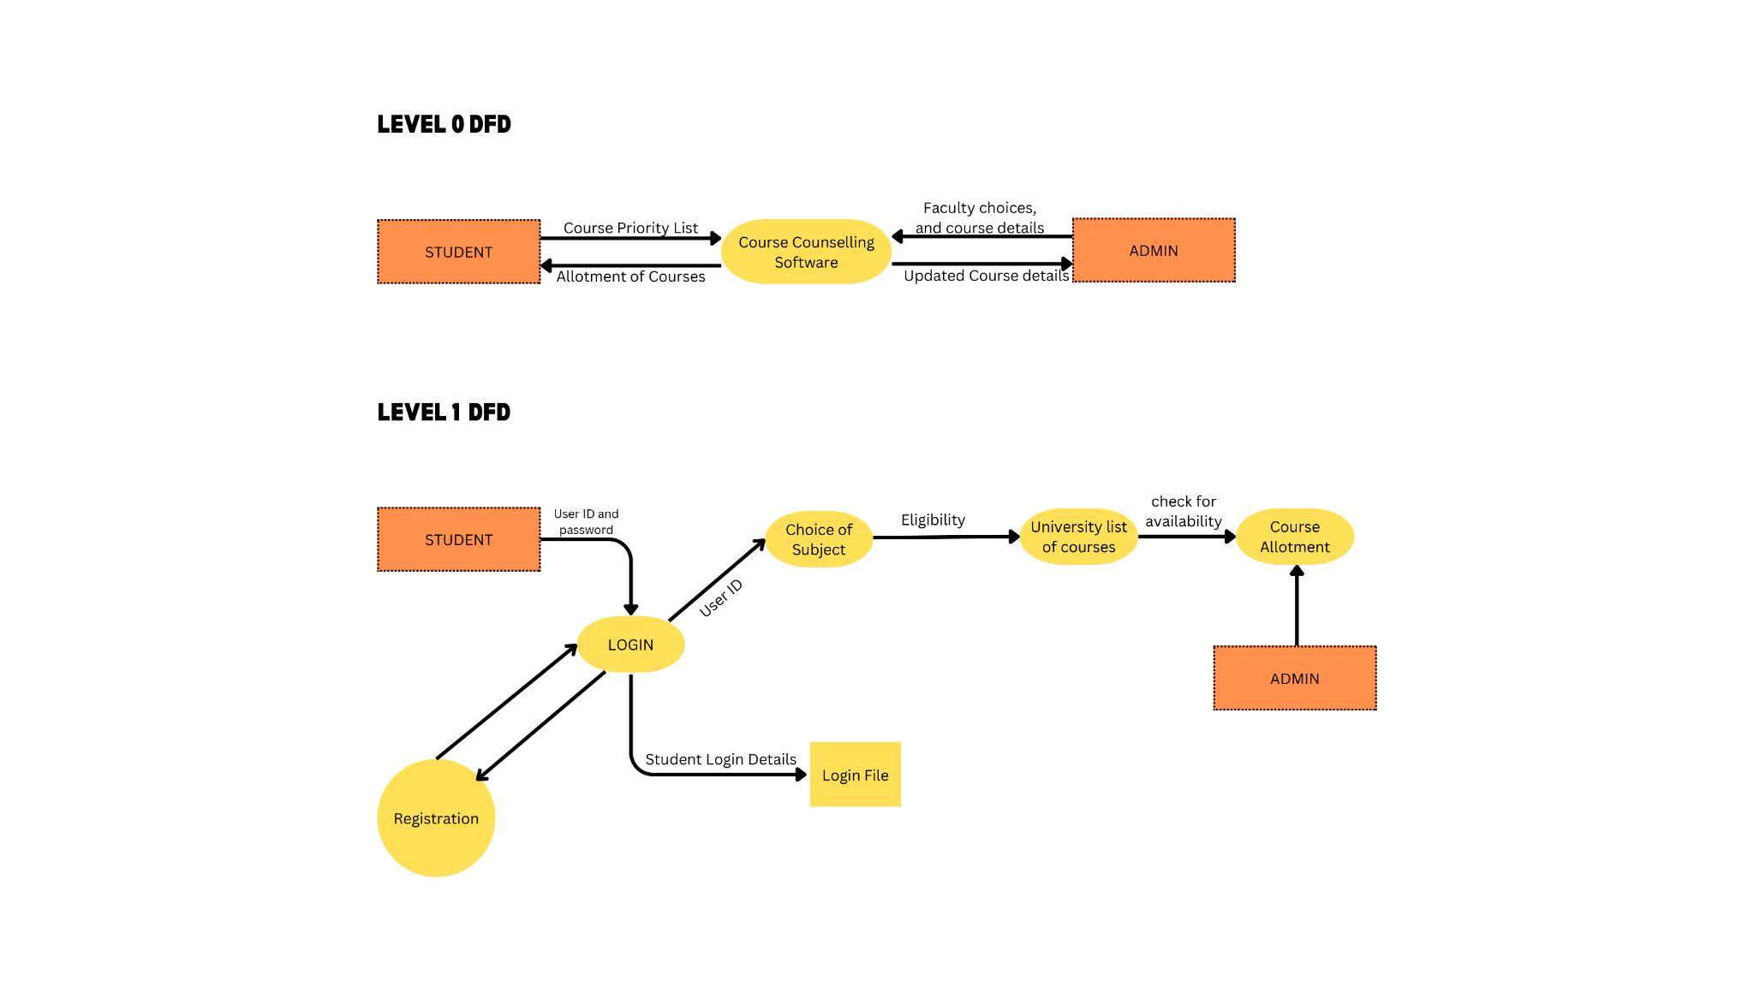
Level 0

Slide 10
Level 1

Slide 11
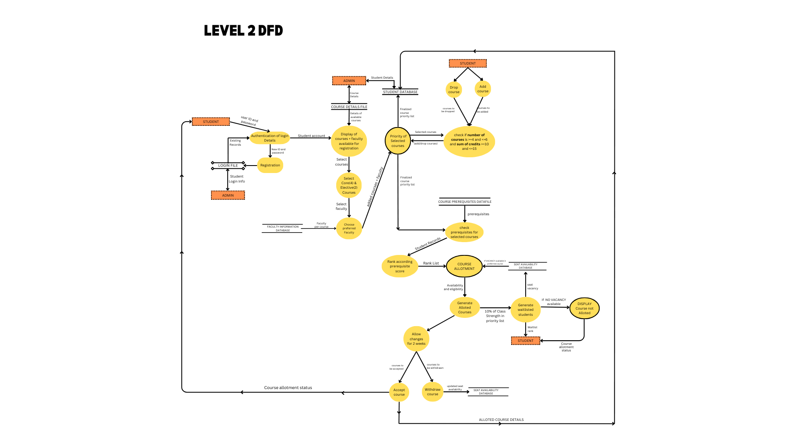
Level 2

Slide 12
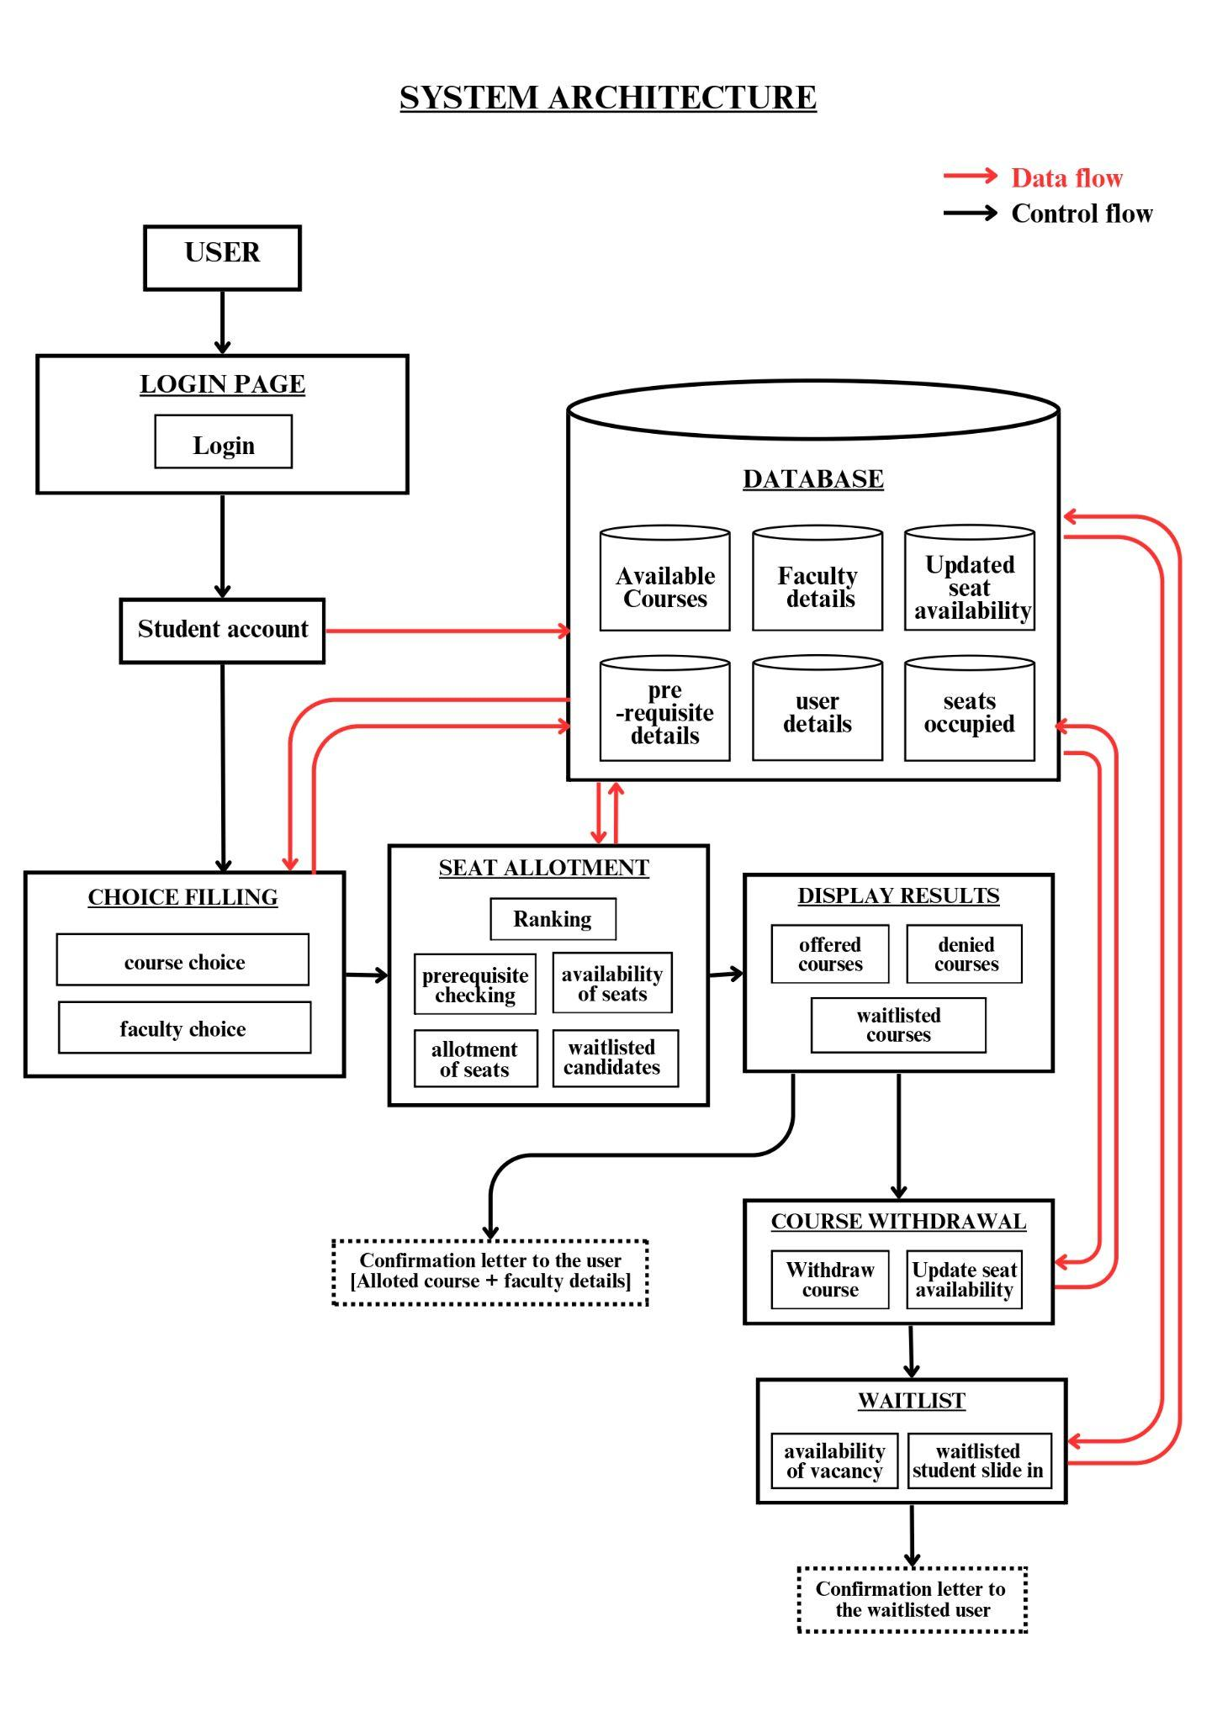
System Architecture

Slide 13
FLOWCHARTS

Slide 14
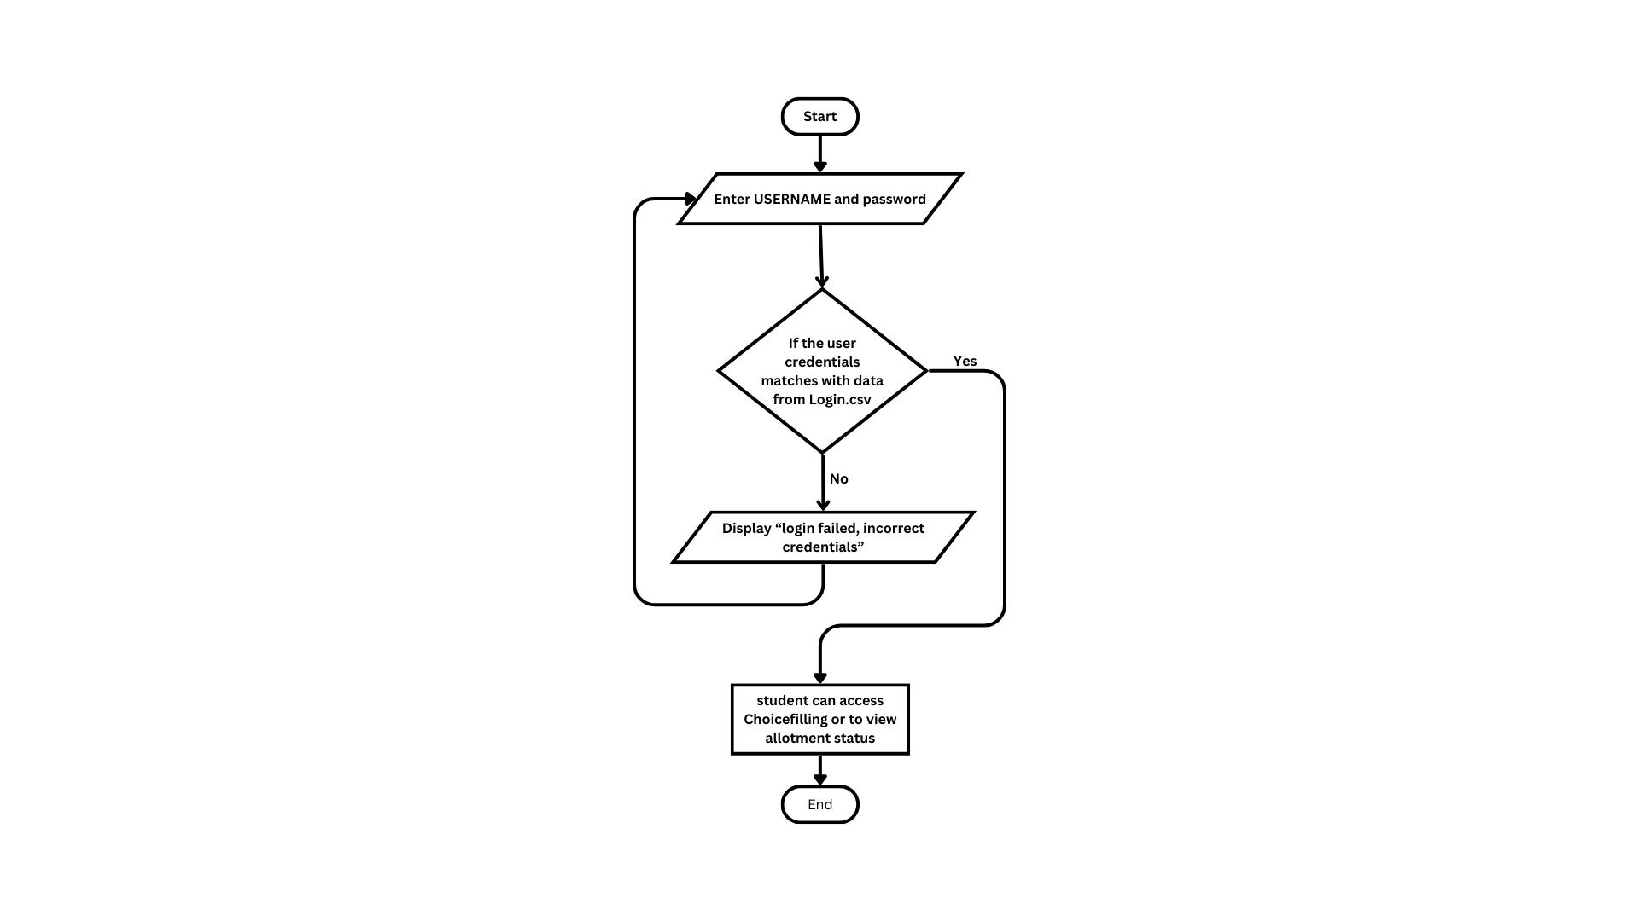
Login Module

Slide 15
Login Module
The program consists of functions to register and authenticate users using a CSV file for data storage.
This function authenticates a user by prompting for a username and password while opening "Login.csv" in read mode.
It reads each line, splitting it into username and password.It then compares the entered credentials with those in the file.
If a match is found, it returns 1 and prints "Login Successful!", otherwise returns 0 and "Login Failed!".
.It repeatedly prompts the user for a choice and executes the corresponding function until the user chooses to exit.
This program ensures basic user authentication through a simple file-based approach.

Slide 16
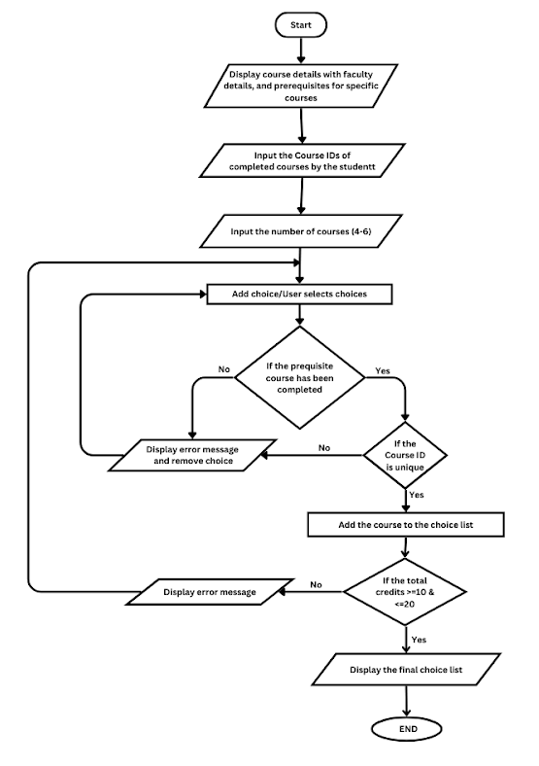
Choice filling Module

Slide 17
Choice filling Module
The main function does the course selection process by reading course data from a CSV file, displaying available courses, and allowing the user to select courses based on prerequisites and credit limits.It opens "Courses.csv" to read course details. It then reads and parses each line from the CSV, skipping the header.
Then all available courses are displayed using display_courses().It then prompts the user to enter completed courses, number of courses and the ID of what they want in the upcoming semester. It validates the input, checks for duplicate selections, and verifies prerequisites using check_prerequisites(). It displays and confirms selected courses and total credits fall within the specified range (10 to 20).
The program provides a robust framework for course selection, ensuring students meet prerequisites and adhere to credit limits, thereby facilitating a structured and error-free registration process.

Slide 18
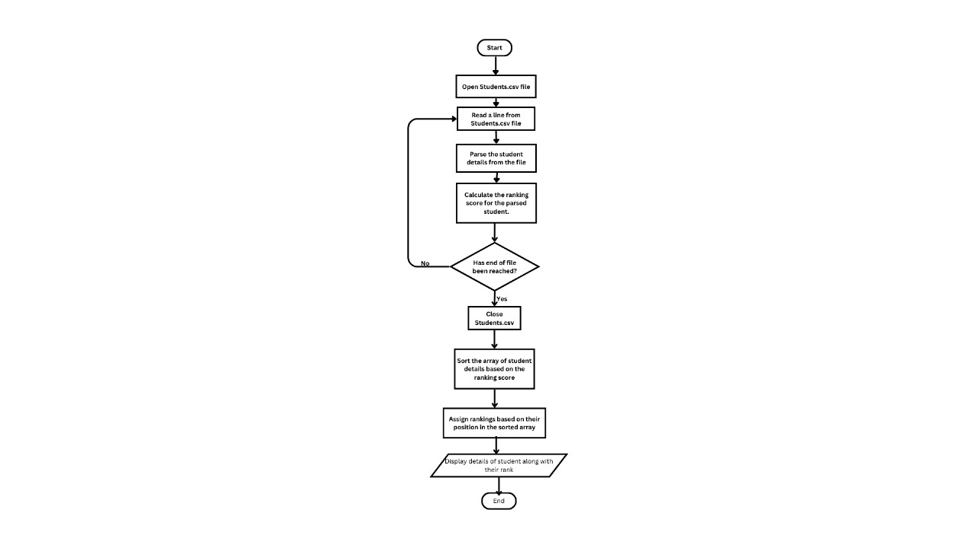
Seat allotment Module

Slide 19
Seat allotment Module
The main function coordinates the entire process of reading student and course data, calculating ranking scores, updating course choices, and allocating courses. It also generates the output files for course allotments and remaining seats. It opens and reads the "Students.csv" file, parses each line into StudentDetail structs and stores them in an array.
Reading and Parsing Students:
Opens "Students.csv".
Skips the header line and parses each subsequent line into StudentDetaial structs.
Calculating and Sorting Rankings:
Calculates ranking scores.
Sorts students based on ranking scores using qsort().
Assigns rankings.
Updating Course Choices:
Reads and updates choices from "choicelist.csv".

Slide 20
Seat allotment Module
4. Reading and Parsing Courses:
Opens "seats.csv".
Skips the header line and parses each subsequent line into Course structs.
Closes the file.
5. Course Allocation:
Iterates through students in ranking order.
Allocates courses based on choices and availability.
Updates remaining seats.
6 Writing Output Files:
Writes the course allocation results to "allotmentlist.csv".
Writes the remaining seats to "remainingseats.csv".
This program ensures a fair and systematic allocation of courses to students based on their preferences, ranking scores, and seat availability.

Slide 21
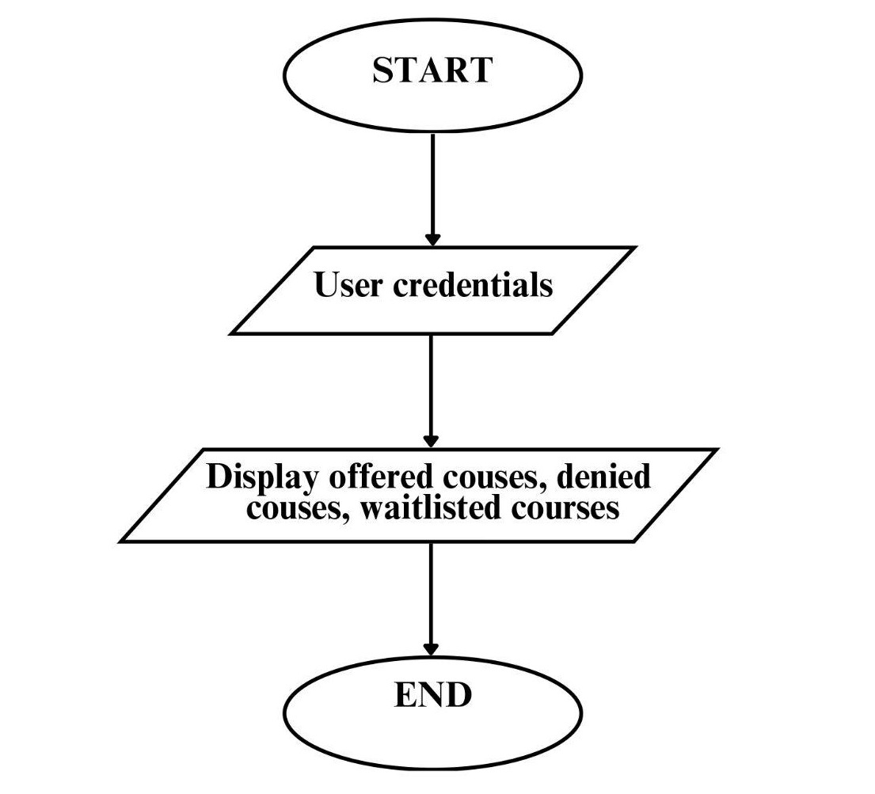
Show results Module
In this module, the student is given the choice to accpet or withdraw the course that has been offered to him/her.
If they accept the courses, it will be updated in the finalallotment.csv file.
Else, in case of withdrawal, it will be updated in the remainingseats.csv and waitlist module will be executed.
User Interaction: The program interacts with the user (student) through the console to confirm course acceptance or rejection.

Slide 22
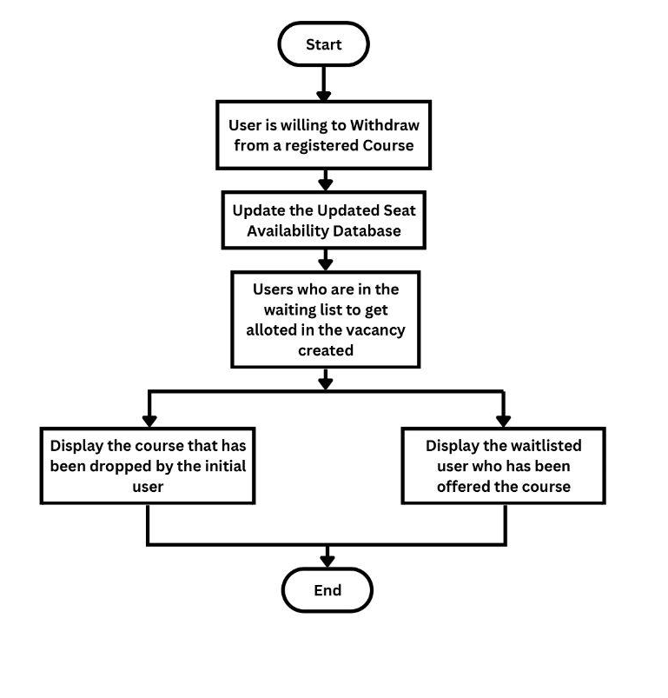
Course Withdrawal Module

Slide 23
Course Withdrawal Module
Student Course Processing
The main function processes each student’s course withdrawals.
It displays the student's allotted courses and asks the student whether they want to accept each course.(User interaction)
Students can only decline a limited number of courses (minimum number of courses constraint which manages error handling).
For each accepted or declined course, the updateSeats function updates the seat availability accordingly.
After processing all students, the main function writes the updated course information back to seats.csv.
This approach ensures a systematic management of student course withdrawals while maintaining data integrity and adhering to constraints.

Slide 24
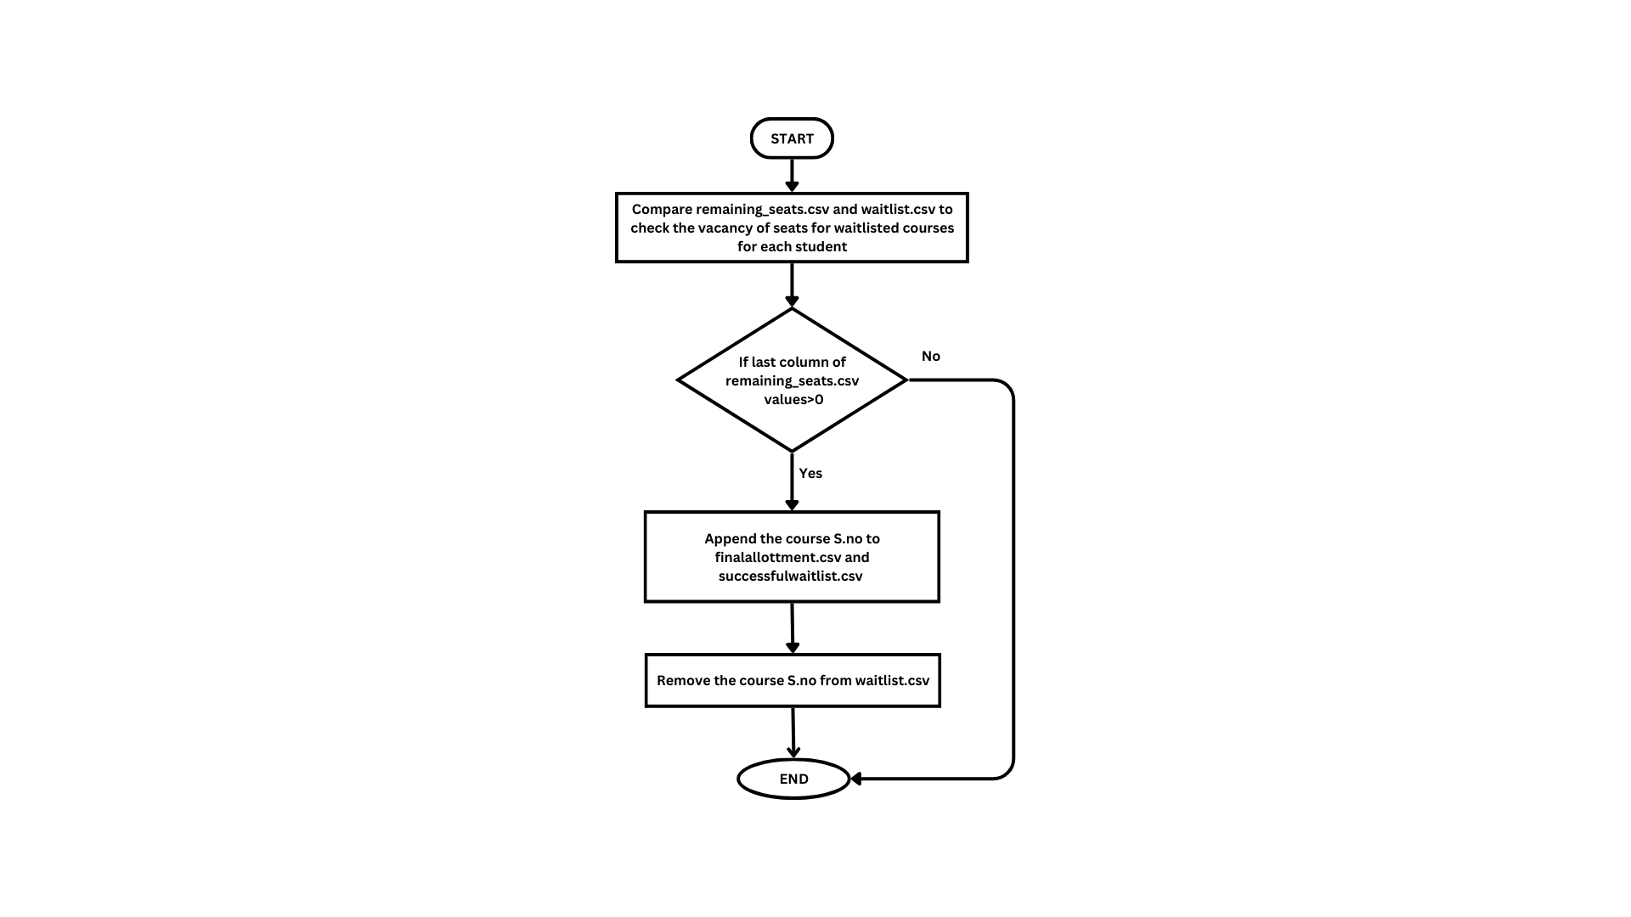
Waitlist Module

Slide 25
Waitlist Module
Reads course data from remainingseats.csv and populates the courses array using parse_course.Uses sscanf to extract the student's name and the waitlisted course serial number (S.no) from the line, and stores them in the provided StudentDetails struct.
Reads waitlisted students data from waitlisted.csv and populates the students array using parse_waitlisted_student.
Iterates through each waitlisted student and tries to allocate the waitlisted course.For each waitlisted student, it checks if the desired course has remaining seats. - If seats are available,it allocates the course to the student and decreases the seatcount. - Prints a message indicating the allocation.
After processing all students, the program writes the updated course information back to remainingseats.csv, ensuring that the new seat counts are saved.
This systematic approach ensures that waitlisted students are allocated courses based on seat availability and updates the course data to reflect these changes.

Slide 26
Non Functional Requirements
1.Performance: The software should be able to handle a large number of concurrent users and high volumes of data without crashing. The response time of the system should be fast enough to provide a seamless user experience..
2.Reliability: The software should be reliable and able to function consistently without unexpected crashes or errors that could affect the counselling process and the results of the students. Data integrity: All student registration data should be accurately stored and maintained without loss or corruption.
3.Scalability: The system should be scalable to accommodate an increasing number of students and courses over time without significant architectural changes. Database scalability: The database should handle a growing volume of course, faculty and student data without performance degradation.

Slide 27
Non Functional Requirements
4.Security: User authentication: The system should use strong encryption methods to secure user credentials during login. Data protection: Personal student information like their exam scores, personal information, and counselling results and registration records should be stored securely and protected from unauthorized access.
5.Usability: User interface: The system should have an intuitive and user-friendly interface to facilitate easy navigation and course selection for students. Accessibility: The system should comply with accessibility standards to ensure usability for users with disabilities.The software should be available 24/7, with minimal downtime or maintenance required, to ensure that students can access the counselling process when they need it.
6. Compliance: The software must adhere to all relevant laws, regulations, and standards related to data privacy, security, accessibility, and other areas that might impact the counselling process.

Slide 28
Non Functional Requirements
7.Compatibility: Browser compatibility: The system should be compatible with major web browsers such as Chrome, Firefox, and Safari. Platform compatibility: The system should be accessible across different operating systems such as Windows, macOS, and Linux.
8.Regulatory Compliance: The system should comply with relevant data protection regulations, such as GDPR or HIPAA, depending on the jurisdiction and nature of data collected. Compliance with university policies: The system should adhere to university policies and guidelines regarding data security, privacy, and academic integrity.

Slide 29
Scopes and Limitations
Online Course Registration: Develop a system enabling students to conveniently and flexibly register for courses online.
Automated Prerequisite Checking: Design a system to automatically verify if students meet the prerequisites for courses, reducing errors and saving time.
Real-Time Course Availability: Implement a system that offers up-to-date information on course availability, allowing students to view which courses are full and which have openings.
Waitlist Functionality: Incorporate a feature enabling students to join waitlists for full courses and receive notifications if spots become available.
Personalized Recommendation: Create a system that delivers personalized course recommendations to students based on their academic history, utilizing machine learning algorithms.

Slide 30
Scope and Limitations
Restricted Course Availability: A primary constraint of course registration systems is the limited availability of courses. Once a course reaches full capacity, students may face waitlists or need to select alternative options.
Absence of Personal Interaction: Course registration platforms often lack the personal touch of in-person registration, making it challenging for students to receive immediate answers to their inquiries or guidance regarding course selection.
Limited Options for Interdisciplinary Courses: In instances where there are few interdisciplinary or cross-listed course offerings, students may have limited opportunities to explore diverse academic fields.
Insufficient Notification of Course Changes or Cancellations: Course registration systems may inadequately notify students about changes or cancellations, leading to inconvenience and confusion. This oversight could result in students missing crucial updates to course details or requirements.

Slide 31
Concerns with respect to society, legal and ethical perspectives
The project should address societal, legal, and ethical considerations to ensure responsible and fair use of data and resources.
This includes safeguarding student privacy, adhering to data protection laws, and maintaining transparency in decision-making processes.
Additionally, the system should promote equal access and opportunity for all students, while avoiding biases or discrimination based on factors such as gender, race, or socioeconomic status.
Ethical guidelines should govern the collection, storage, and use of student data, ensuring it is handled responsibly and ethically throughout the counselling process.

Slide 32
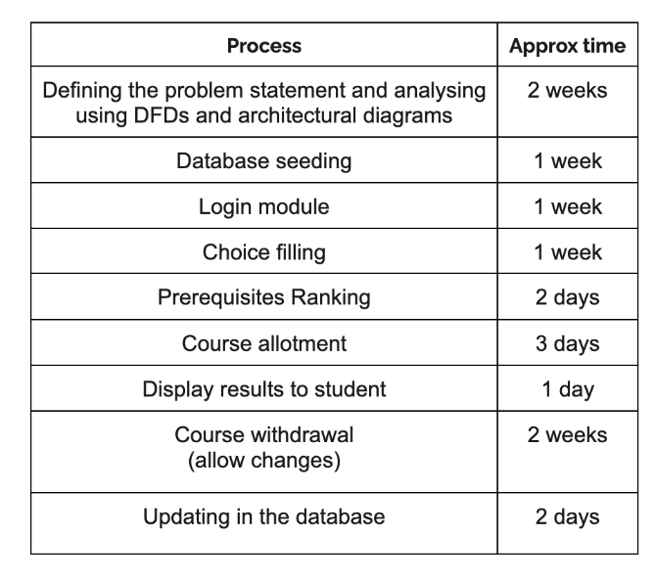
Timeline for completing each module and for testing

Slide 33
THANK YOU

